Slide 1

Calnexus Solutions
Our mission is to help our customers deliver awesome enterprise software quickly.

Slide 2

Custom Hospital management Solution
For Marura Hospital

Slide 3
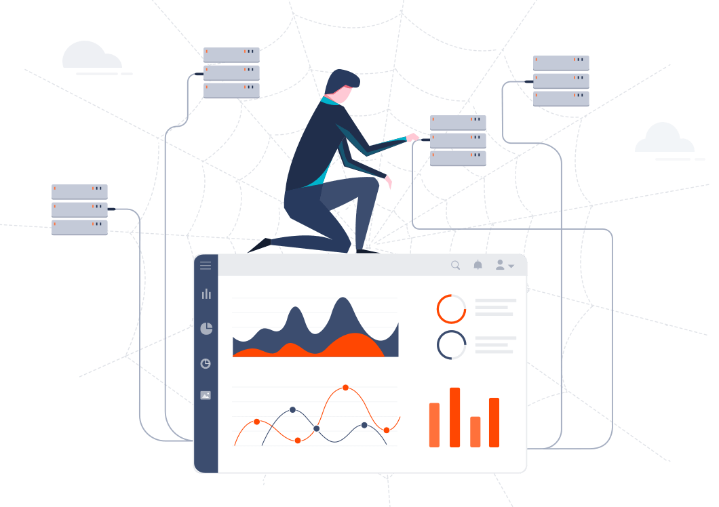
Why introduce a Custom Hospital Management system
Organizations are accumulating data at a faster pace than ever before. However, this data is only valuable when converted into information that can be easily digested by stakeholders. Sharing critical, easy-to-read pieces of information directly with stakeholders will provide valuable insights that will empower you to transform your business.
Creating a custom solution will help and ease the process of porting all the existing hospital records and train the new system to behave exactly like the existing system.
The new system will solve all the critical challenges faced from the existing system and add more functionalities, control and more improved security features

Slide 4

Out of the box features we will provide with the custom solution

Slide 5

Advanced Collaboration Among Departments
This feature will let departments view and review patient data with ease.
The collaboration features will revolve around real-time messaging Platform and easy file sharing features
Built-in support for comments makes collaboration incredibly easy and effective.

Slide 6

World-class infrastructure
The Custom Solution will be powered by Microsoft’s Azure platform. Microsoft Azure is powered by infrastructure spanning more than 100 highly secure facilities worldwide and linked by one of the largest networks on earth.

Slide 7
Access from any platform
Your users can view the software on any platform, including Windows®, Linux, macOS®, iOS®, Android™, and Chrome OS™. Bold BI is supported by any device, including tablets and phones.

Slide 8
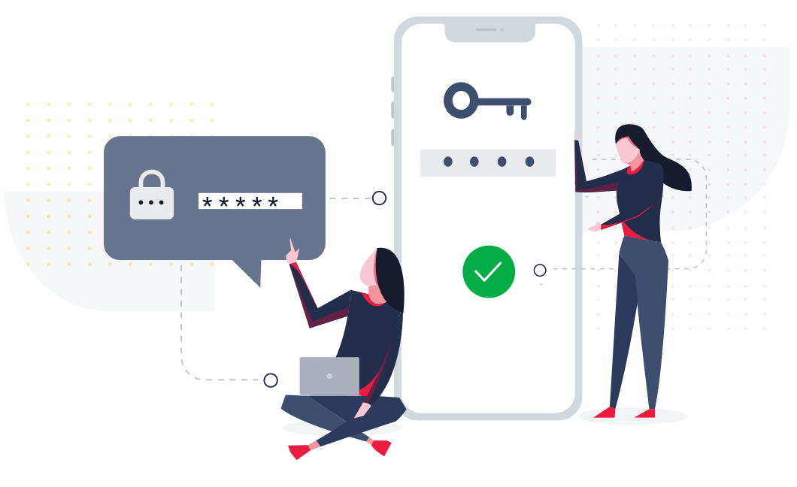
Multi-factor authentication
Multi-factor authentication is available when securing the system with providers that support MFA, such as Office 365.
The system will allow different access and authorization levels. It will be based on a role bases authorization where each user can only access the system based on their roles and access level.

Slide 9

Advanced Traffic Security
All traffic will be secured using Transport Layer Security protocol (TLS 1.2). You can rest assured that your data will be safe.

Slide 10
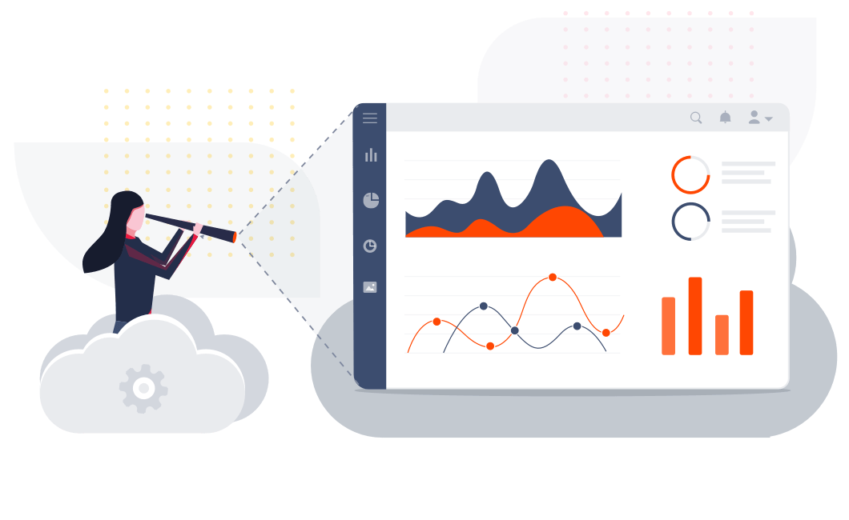
AI-powered insights
The system will have the capability to derive and publish artificial intelligence powered insights using the existing patients data.
This will help all the teams in better planning of the facilities and available infrastructure with ease.

Slide 11
Patient Management
Patient management module will have the ultimate features second to none powered by a simple user interface and precise quality user experience. Its features will include and not limited to
Ability to request appointment.
Keep patient records, prescriptions and medications.
Keep track of patient payments.
See all customer diagnostics.
Manage operation reports.
Private communication between doctor and patient.

Slide 12
Hospital Based Management
The custom solution will have features that manage core hospital operations which include:
Manage Blood Banks
Keep records of blood donors
Allotments of beds and wards
Keep Medicine Records
Pay slip generation for hospital staff

